Slide 1

Green IOT Smart Cities

Slide 2
Smart City : Introduction
Definition of Smart City by wikipedia:
A smart city is an urban development vision to integrate information and communication technology (ICT) and Internet of things (IOT) technology in a secure fashion to manage a city's assets.
These assets include local departments' information systems, schools, libraries, transportation systems, hospitals, power plants, water supply networks, waste management, law enforcement, and other community services.
ICT allows city officials to interact directly with the community and the city infrastructure and to monitor what is happening in the city, how the city is evolving, and how to enable a better quality of life.

Slide 3
Why Smart Cities are needed now?
The need to handle global environment and urbanization problems
Global warming and climate change
Population increase and resource depletion
Adverse effects of increasing urbanization
The need for a long-term approach to developing sustainable cities
Managing the lifecycles of cities
Improving economic performance over the entire Lifecycle
e.g., pollution, that are very expensive to clean up later.
Enhancing city competitiveness

Slide 4
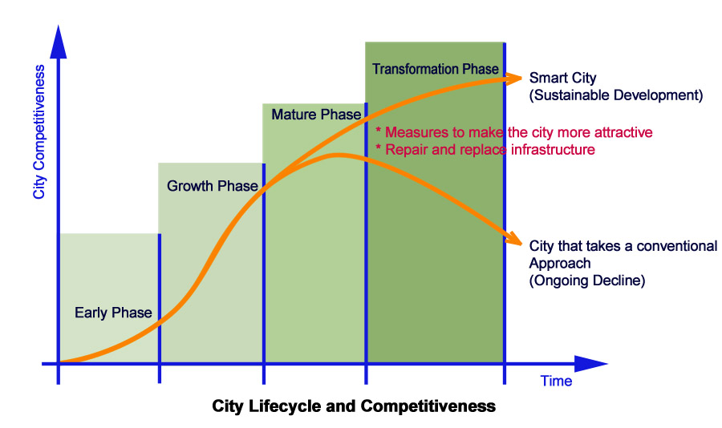
Why Smart Cities are needed now?
The need for a long-term approach to developing sustainable cities
Managing the lifecycles of cities
Early phase: Provide the infrastructure needed for the operation of the city.
Growth Phase: Expand and intensify the infrastructure to ensure that supply can keep the pace with increasing demands of the growing demand.
Mature phase: Enhance infrastructure to ensure the delivery of high-quality services based on criteria such as ease-of-use and comfort.
Transformation phase: Integrate infrastructure systems to satisfy social values such as aiding, or at least avoiding damage to, the natural environment.
¹Enhancing city competitiveness - In terms of services (education ,healthcare), waste management, water management, transportation, safety etc.

Slide 5
"Smart Cities" includes
Smart Building & Home
Smart Transportation
Smart Energy (renewable generation & storage)
Smart Water Management
Smart Waste Management (recycling of waste, residual management, Recovery of waste organics & Energy)
Smart Education (e-Education)
Smart Medical Facility (e-Medical)
Smart Communications
Smart Networks
Notes:
Advance Meter Infrastructure(AMI)
Peak Load Management(PLM)
Outage Management System(OMS)
Power Quality Management(PQM)

Slide 6
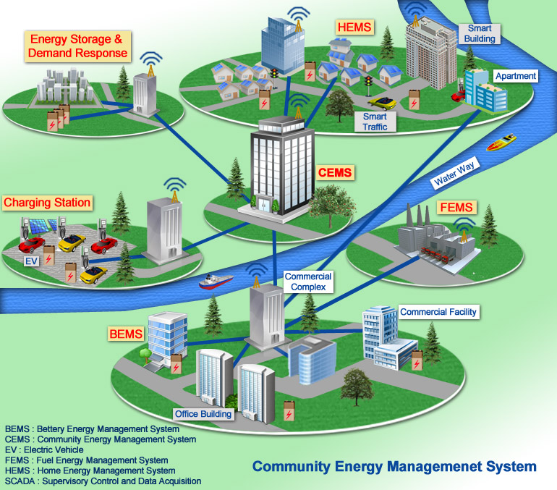
SMART CITY example
Notes:
Yokohama Smart City Project (YSCP)
The Yokohama Smart City Project aims to establish comfortable eco-lifestyles and build systems that use energy effectively on a community-wide scale in order to cope with climate change and reduce CO₂ emissions by breaking away from dependence on fossil fuels.
The Yokohama Smart City Project started tests in October 2012 to reduce energy consumption and CO₂ emissions through wide-area energy management by introducing energy management systems (EMSes) for buildings, factories, and houses as well as electric vehicles (EVs) and storage batteries in the city of Yokohama.
This project is a large-scale experiment in which the city's many consumers participate-the project aims to test the effectiveness of wide-area, large-scale demand response ("DR," demand/supply control) and system stabilization through storage battery control.
CEMS connects consumers (buildings, factories, houses, and EVs) and storage battery SCADA through standard interfaces to control overall energy demand via various DR incentives while monitoring local energy demand.
BEMS reduces peak energy consumption of several buildings through DR using algorithms to optimally distribute the surplus power and controls operation of in-building energy creation and storage equipment that support DR.
Storage battery SCADA links supply/demand adjustment storage batteries and consumers' storage batteries for system stabilization and DR-based control.
HEMS shifts peak energy consumption through visualization of energy consumption and controls operation of home appliances automatically through automatic DR, while combining energy creation and storage equipment in condominiums.
CEMS: Community Energy Management System BEMS: Building Energy Management System HEMS: Home Energy Management System SCADA: Supervisory Control And Data Acquisition DR: Demand Response

Slide 7
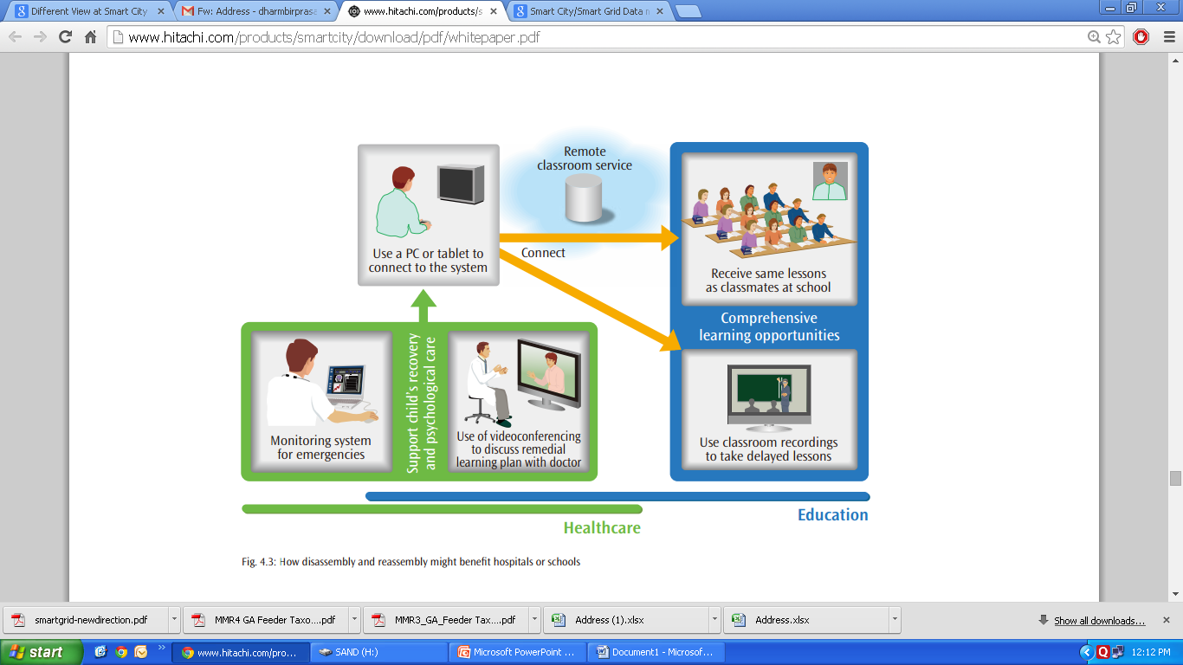
Remote communication services for Education & Healthcare
SMART CITY example

Slide 8
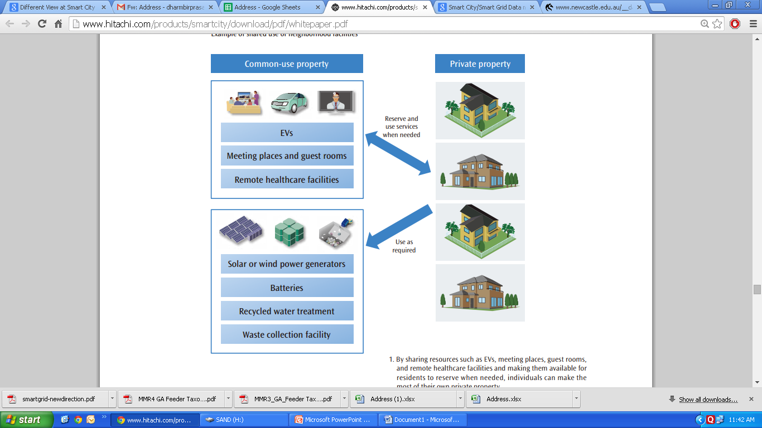
Shared use of neighborhood facilities
SMART CITY example

Slide 9
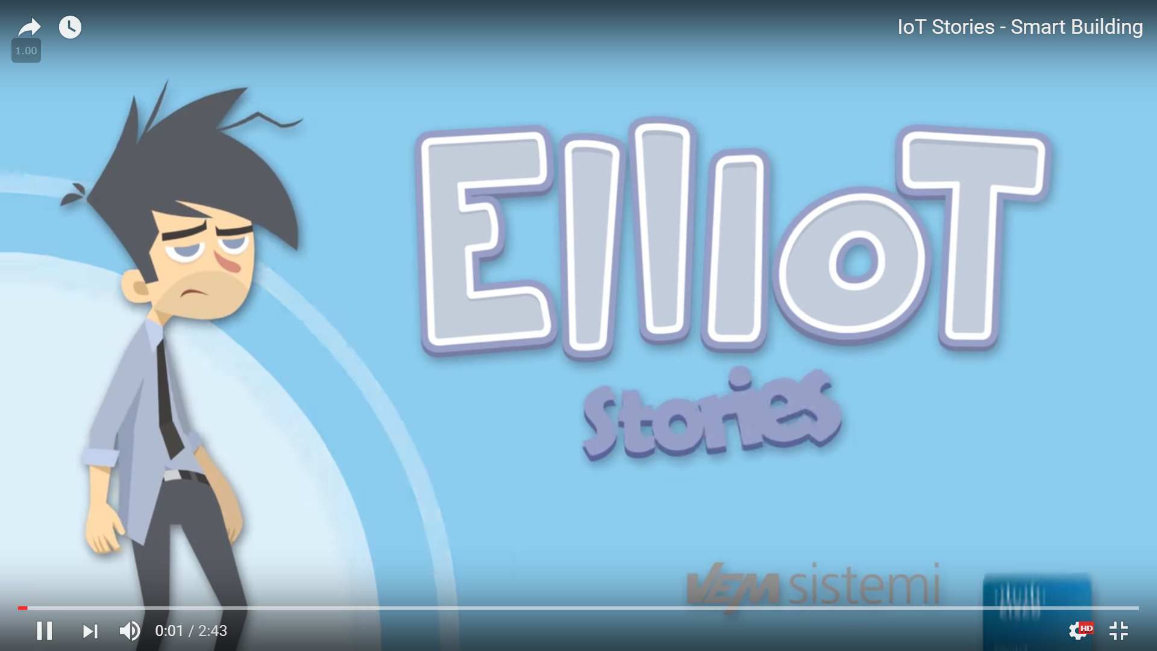

IoT Stories - Smart Building
https://www.youtube.com/watch?v=RmuEurPH9M4

